Slide 1
Decode Gaming Behavior
Name: Prexa Patel Batch: MIP-DA-06 Designation: Data Analyst Intern
Mentorness Internship program

Slide 2
Table of contents
01
02
03
04
Overview
Problem Statement
Dataset Description
SQL Queries

Slide 3
01
Overview

Slide 4

Overview
The project "Decode Gaming Behavior" involves analyzing a dataset related to a game
The objective is to delve into the data to understand various aspects of player behavior within the game. This could encompass tasks such as identifying patterns in player engagement, analyzing progression through levels, investigating player demographics, and potentially predicting player behavior or preferences.
The overarching goal is likely to apply data analysis and uncover meaningful trends and patterns within the gaming dataset, ultimately contributing to a better understanding of player behavior within the game environment.

Slide 5
02
Problem Statement

Slide 6
Problem Statement
Players play a game divided into 3-levels (L0, L1 and L2)
Each level has 3 difficulty levels (Low, Medium, High)
At each level, players have to kill the opponents using guns/physical fight
Each level has multiple stages.
A player can only play L1 using its system generated L1_code
Only players who have played Level1 can possibly play Level2 using its system generated L2_code
By default a player can play L0
Each player can login to the game using a Dev_ID
Players can earn extra lives at each stage in a level

Slide 7
03
Dataset Description

Slide 8
Dataset Description
Player Details Table
Level Details Table
`P_ID`: Player ID
`PName`: Player Name
`L1_status`: Level 1 Status
`L2_status`: Level 2 Status
`L1_code`: Systemgenerated Level 1 Code
`L2_code`: Systemgenerated Level 2 Code
`P_ID`: Player ID
`Dev_ID`: Device ID
`start_time`: Start Time
`stages_crossed`: Stages Crossed
`level`: Game Level
`difficulty`: Difficulty Level
`kill_count`: Kill Count
`headshots_count`: Headshots Count
`score`: Player Score
`lives_earned`: Extra Lives Earned

Slide 9
04
SQL Queries

Slide 10
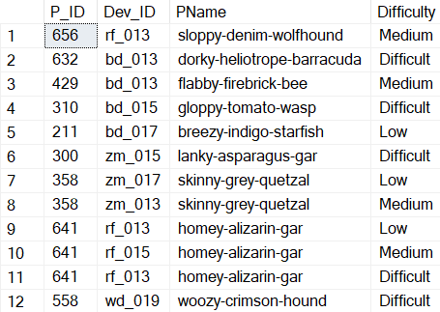
Extract P_ID,Dev_ID,PName and Difficulty_level of all players at level 0
01
SELECT PD.P_ID, LD.Dev_ID, PD.PName, LD.Difficulty
FROM player_details PD
JOIN level_details LD ON PD.P_ID = LD.P_ID
WHERE LD.[Level] = 0

Slide 11

Find Level1_code wise Avg_Kill_Count where lives_earned is 2 and atleast 3 stages are crossed
02
SELECT T2.L1_Status, AVG(Kill_Count) AS Avg_Kill_Count
FROM level_details T1
JOIN player_details T2 ON T1.P_ID = T2.P_ID
WHERE T1.Lives_Earned = 2
AND T1.Stages_crossed >= 3
GROUP BY T2.L1_Status

Slide 12

Find the total number of stages crossed at each diffuculty level where for Level2 with players use zm_series devices. Arrange the result in decsreasing order of total number of stages crossed.
03
SELECT Difficulty, SUM(Stages_crossed) AS SUM_of_Stages_crossed_byDifficulty
FROM level_details
WHERE [Level] = 2 AND Dev_ID LIKE 'zm_%'
GROUP BY Difficulty
ORDER BY SUM(Stages_crossed) DESC

Slide 13
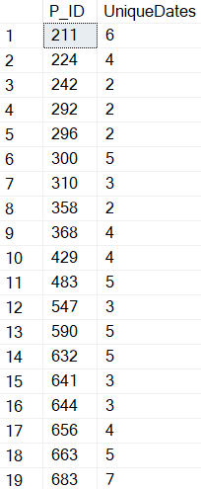
Extract P_ID and the total number of unique dates for those players who have played games on multiple days.
04
SELECT P_ID, COUNT(DISTINCT([Timestamp])) AS UniqueDates
FROM level_details
GROUP BY P_ID
HAVING COUNT(DISTINCT([Timestamp]))>1

Slide 14
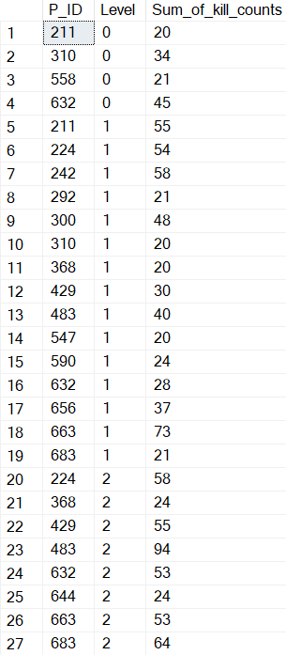
Find P_ID and level wise sum of kill_counts where kill_count is greater than avg kill count for the Medium difficulty.
05
SELECT P_ID, [Level], SUM(Kill_Count) AS Sum_of_kill_counts
FROM level_details
WHERE Kill_Count > (
SELECT AVG(Kill_Count)
FROM level_details
WHERE Difficulty = 'Medium’
)
GROUP BY P_ID, [Level]

Slide 15
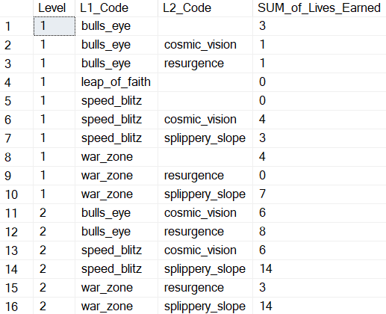
Find Level and its corresponding Level code wise sum of lives earned excluding level 0. Arrange in asecending order of level.
06
SELECT [Level], L1_Code, L2_Code,
SUM(Lives_Earned) AS SUM_of_Lives_Earned
FROM Level_details LD
JOIN player_details PD ON LD.P_ID = PD.P_ID
WHERE [Level] <> 0
GROUP BY [Level], PD.L1_Code, PD.L2_Code
ORDER BY [Level]

Slide 16
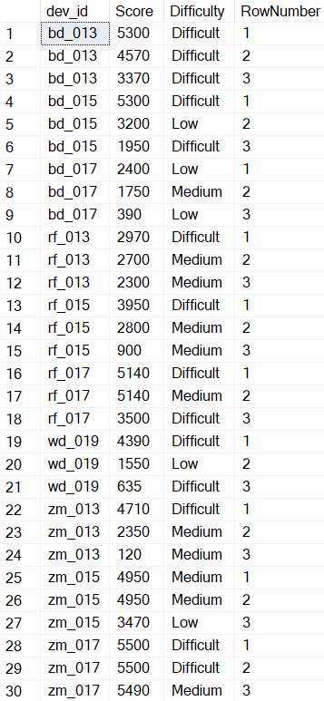
Find Top 3 score based on each dev_id and Rank them in increasing order using Row_Number. Display difficulty as well.
07
SELECT dev_id, Score, Difficulty, RowNumber
FROM
(
SELECT dev_id, Score, Difficulty,
ROW_NUMBER() OVER (PARTITION BY
dev_id ORDER BY Score DESC) AS
RowNumber
FROM level_details
) T2
WHERE T2.RowNumber <= 3

Slide 17
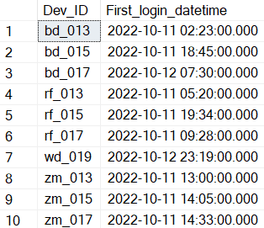
Find first_login datetime for each device id
08
SELECT Dev_ID, MIN([TimeStamp]) AS First_login_datetime
FROM level_details
GROUP BY Dev_ID

Slide 18
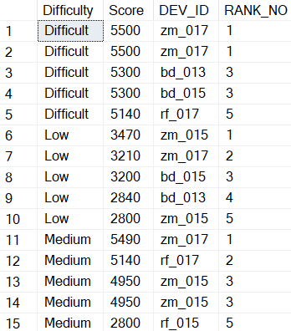
Find Top 5 score based on each difficulty level and Rank them in increasing order using Rank. Display dev_id as well.
09
SELECT Difficulty, Score, DEV_ID, RANK_NO
FROM
(
SELECT Difficulty, SCORE, DEV_ID,
RANK() OVER (PARTITION BY Difficulty
ORDER BY SCORE DESC) AS RANK_NO
FROM level_details LD
) T1
WHERE RANK_NO <= 5
ORDER BY DIFFICULTY, RANK_NO

Slide 19
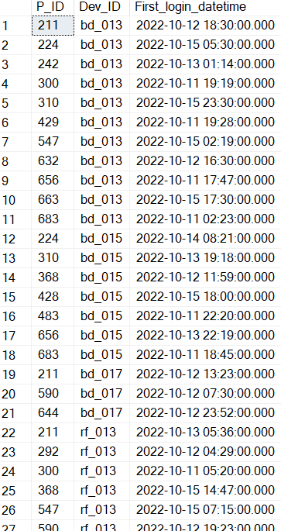
Find the device ID that is first logged in(based on start_datetime) for each player(p_id). Output should contain player id, device id and first login datetime.
10
SELECT P_ID, Dev_ID, MIN([TimeStamp]) AS First_login_datetime
FROM level_details
GROUP BY P_ID, Dev_ID

Slide 20
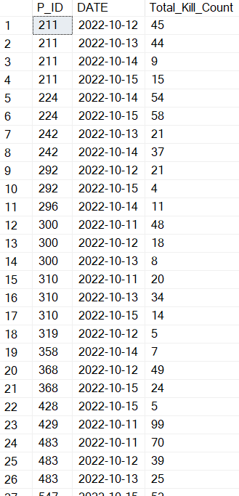
For each player and date, how many kill_count played so far by the player. That is, the total number of games played by the player until that date.
11
a) window function
SELECT DISTINCT P_ID, CAST([TimeStamp] AS DATE) AS [DATE],
SUM(Kill_Count) OVER (
PARTITION BY P_ID, CAST([TimeStamp] AS DATE)
ORDER BY CAST([TimeStamp] AS DATE)
) AS Total_Kill_Count
FROM level_details
ORDER BY P_ID, CAST([TimeStamp] AS DATE)

Slide 21
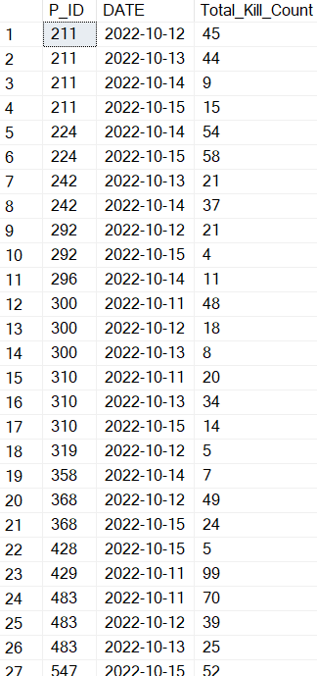
For each player and date, how many kill_count played so far by the player. That is, the total number of games played by the player until that date.
11
b) without window function
SELECT P_ID, CAST([TimeStamp] AS DATE) AS [DATE],
SUM(Kill_Count) AS Total_Kill_Count
FROM level_details
GROUP BY P_ID, CAST([TimeStamp] AS DATE)
ORDER BY P_ID, CAST([TimeStamp] AS DATE)

Slide 22
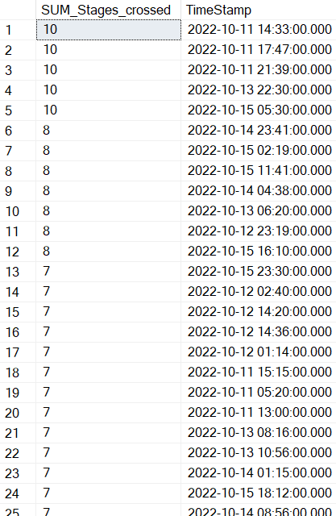
Find the cumulative sum of stages crossed over a start_datetime
12
SELECT SUM(Stages_crossed) AS SUM_Stages_crossed, TimeStamp
FROM(
SELECT Stages_crossed, TimeStamp,
ROW_NUMBER() OVER (
ORDER BY TimeStamp DESC
) AS RowNumber
FROM level_details
) T2
GROUP BY TimeStamp
ORDER BY SUM_Stages_crossed DESC

Slide 23
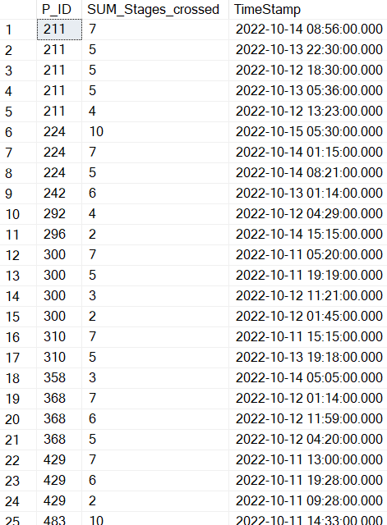
Find the cumulative sum of an stages crossed over a start_datetime for each player id but exclude the most recent start_datetime
13
SELECT P_ID, SUM(Stages_crossed) AS SUM_Stages_crossed, TimeStamp
FROM(
SELECT P_ID, Stages_crossed, TimeStamp,
ROW_NUMBER() OVER (
PARTITION BY P_ID
ORDER BY TimeStamp DESC
) AS RowNumber
FROM level_details
) T2
WHERE RowNumber > 1
GROUP BY P_ID, TimeStamp
ORDER BY P_ID, SUM_Stages_crossed DESC

Slide 24
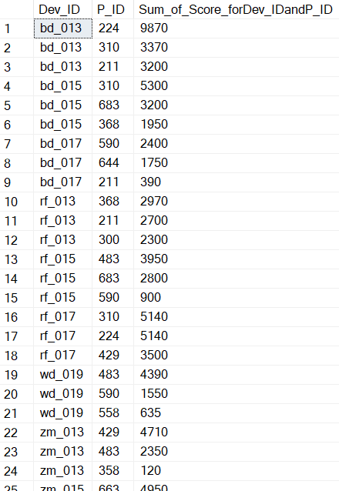
Extract top 3 highest sum of score for each device id and the corresponding player_id
14
SELECT Dev_ID, P_ID, Sum_of_Score_forDev_IDandP_ID
FROM
(
SELECT Dev_ID, P_ID, SUM(Score) AS Sum_of_Score_forDev_IDandP_ID,
ROW_NUMBER() OVER (PARTITION BY Dev_ID
ORDER BY SUM(Score) DESC) AS ROWNUMBER
FROM Level_details
GROUP BY Dev_ID, P_ID
) T1
WHERE ROWNUMBER <= 3

Slide 25
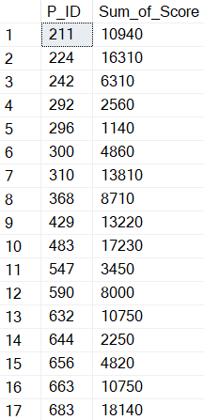
Find players who scored more than 50% of the avg score scored by sum of scores for each player_id
15
SELECT P_ID, SUM(Score) AS Sum_of_Score
FROM Level_details
GROUP BY P_ID
HAVING SUM(Score) > (50 * (SELECT AVG(Score) FROM level_details)/100)

Slide 26
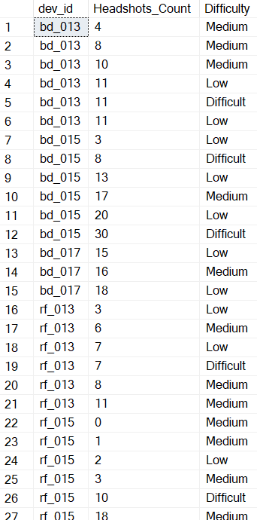
Create a stored procedure to find top n headshots_count based on each dev_id and Rank them in increasing order using Row_Number. Display difficulty as well.
16
ALTER PROC [dbo].[Proc_Top_n_Headshot_Count]
(@n INT)
AS
BEGIN
SELECT dev_id, Headshots_Count, Difficulty
FROM (
SELECT dev_id, Headshots_Count, Difficulty,
ROW_NUMBER() OVER (
PARTITION BY dev_id
ORDER BY Headshots_Count
) AS RowNumber
FROM level_details) T2
WHERE T2.RowNumber <= @n
ORDER BY dev_id, T2.RowNumber
/*
EXEC [Proc_Top_n_Headshot_Count] @n = 6
*/
END

Slide 27

Create a function to return sum of Score for a given player_id.
17
ALTER FUNCTION [dbo].[Sum_of_Score]
(
@player_id INT
)
RETURNS INT
AS
BEGIN
DECLARE @Sum_of_Score INT
SELECT @Sum_of_Score = SUM(LD.Score)
FROM level_details LD
WHERE LD.P_ID = @player_id
GROUP BY LD.P_ID
RETURN @Sum_of_Score
/*
SELECT [dbo].[Sum_of_Score] (644) AS Sum_of_Score
*/
END

Slide 28
Thanks
Do you have any questions?
prexapatel222@gmail.com
www.linkedin.com/in/prexapatel222 https://github.com/Prexa22

